Slide 1
Rowayton Community Center
Phase IV – Interior Renovation
October 19, 2016

Slide 2
Previous Projects at RCC
Library (undertaken by Library Board)
Historic Roof and Façade Repair and Restoration of Main Building
Historic Roof and Restoration of Greenhouse, Ice House and Garage
Electrical and HVAC upgrade
Site Circulation and New Driveway
Potting Shed (Rowayton Gardeners and 6TD)
Paddle Tennis (improvements undertaken by RPTA)
Courtyard and Drainage (current)

Slide 3
Goals of Project
Provide primary entrance
Reduce operating costs (energy)
Increase revenue from outside users
Increase building functionality
Maximize natural light
Maintain historic integrity
Enhance building safety
Modernize for contemporary uses

Slide 4
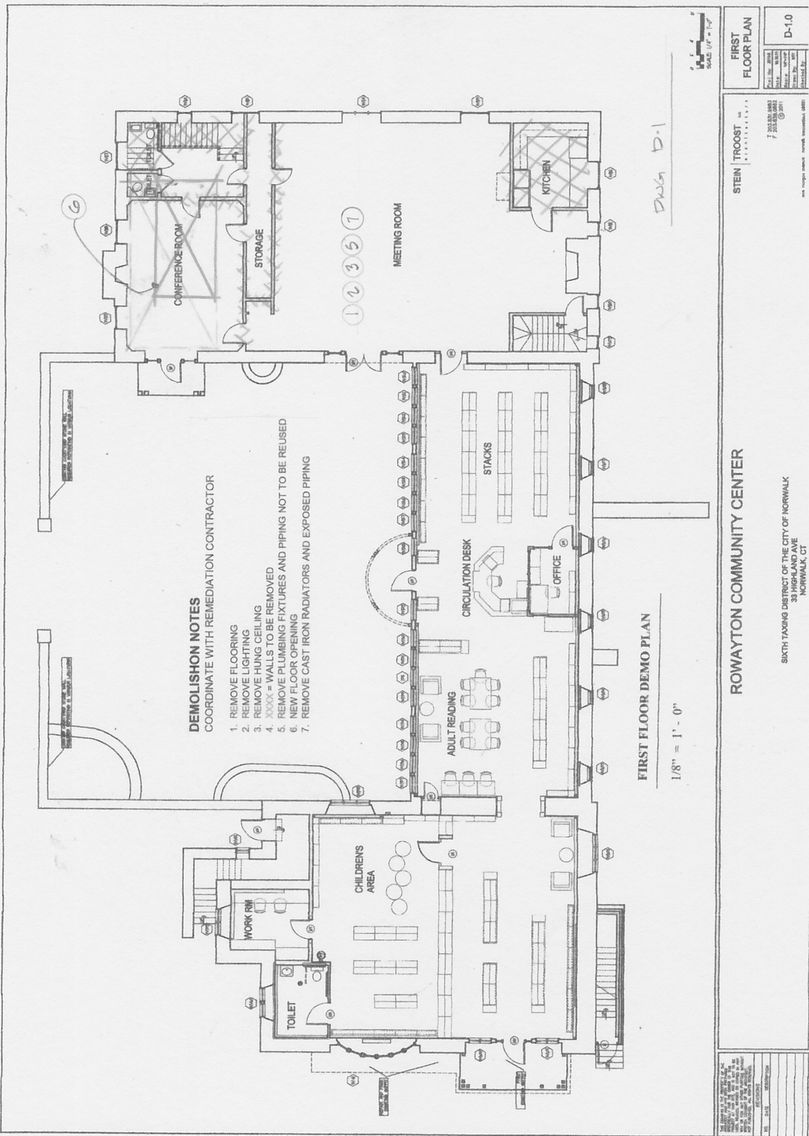
Existing Plans: major work areas - Main Floor

Slide 5
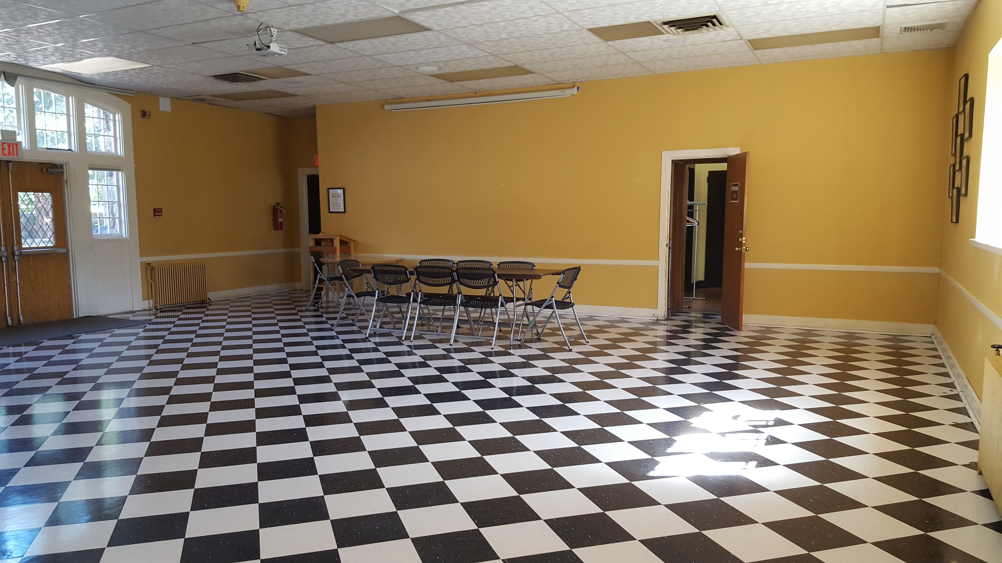
Main Floor – Moose Room

Slide 6
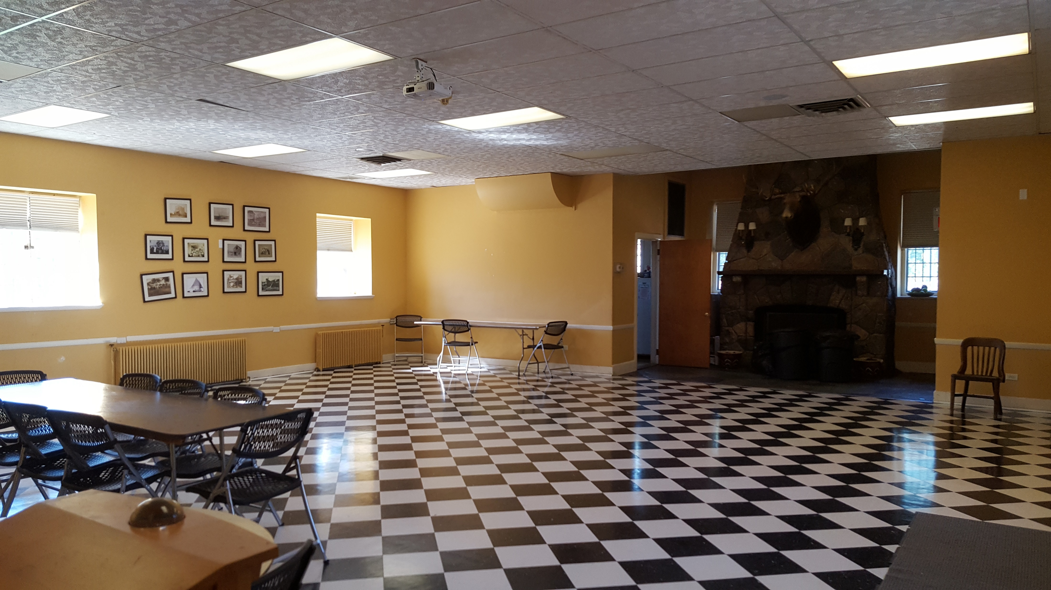
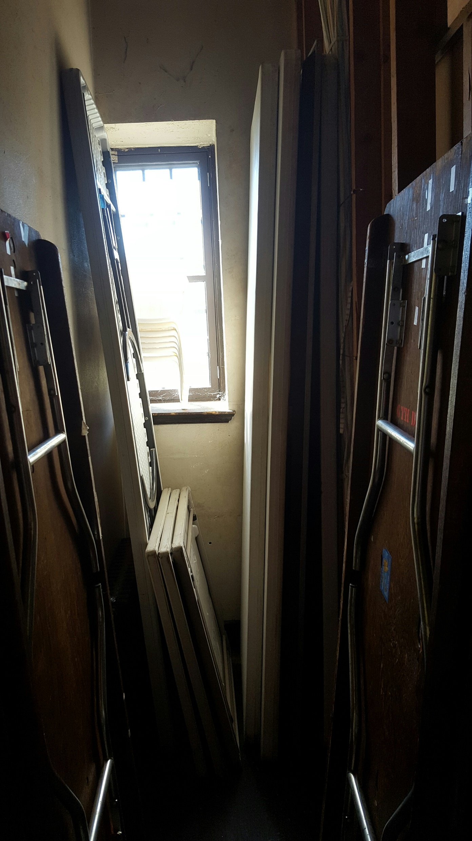
Main Floor – Moose Room and Storage

Slide 7
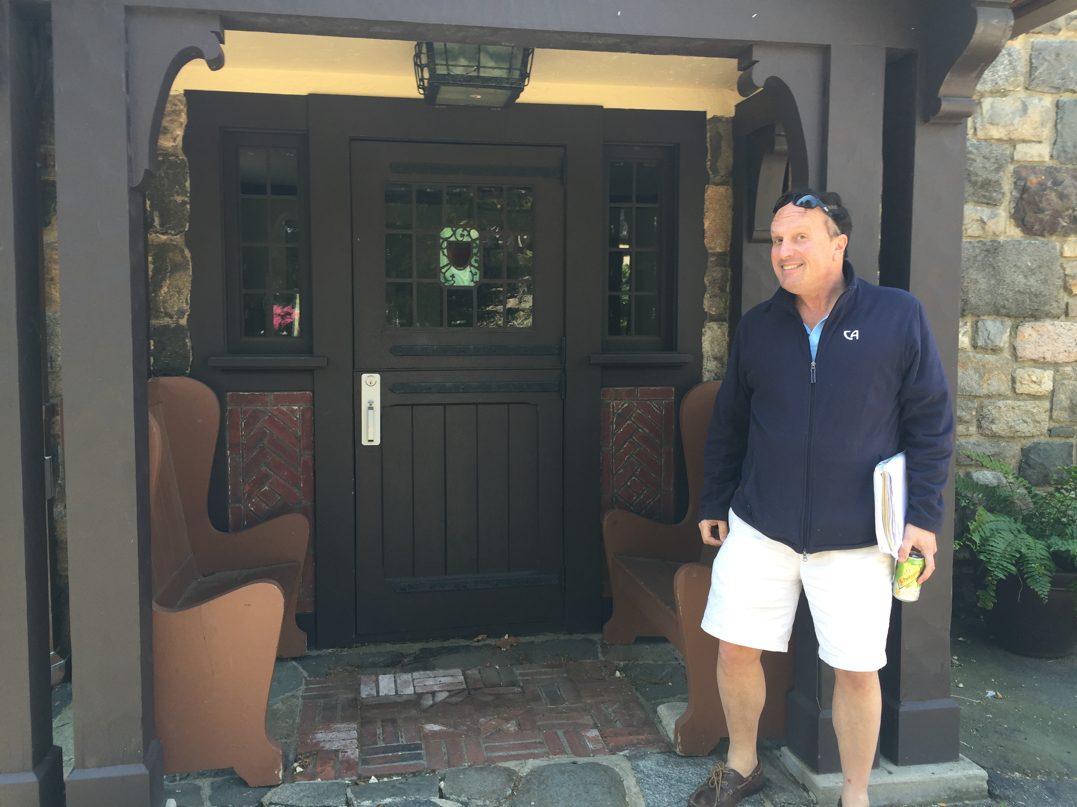
Main Floor – Entrance

Slide 8
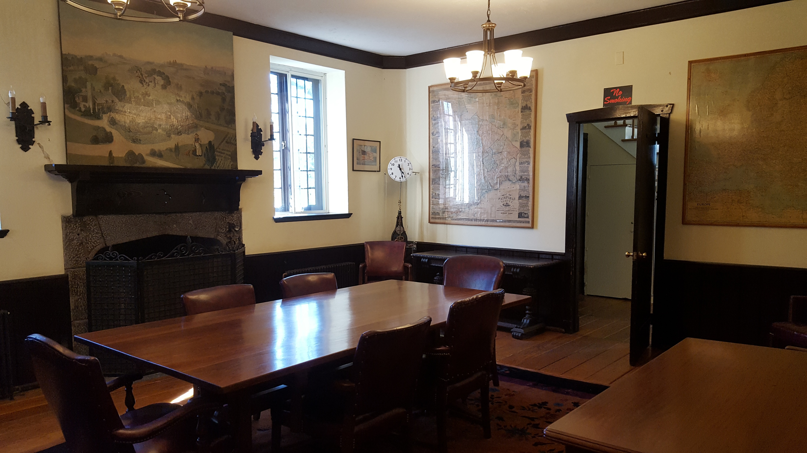
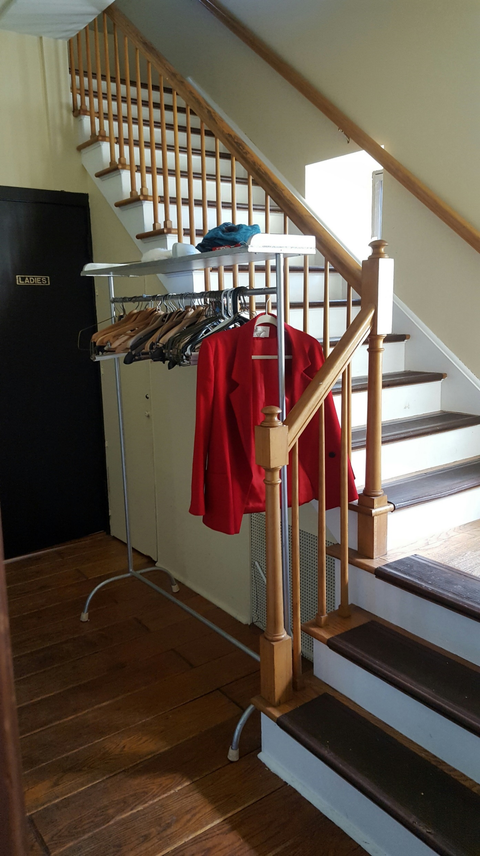
Main Floor – Entrance and Stairs

Slide 9
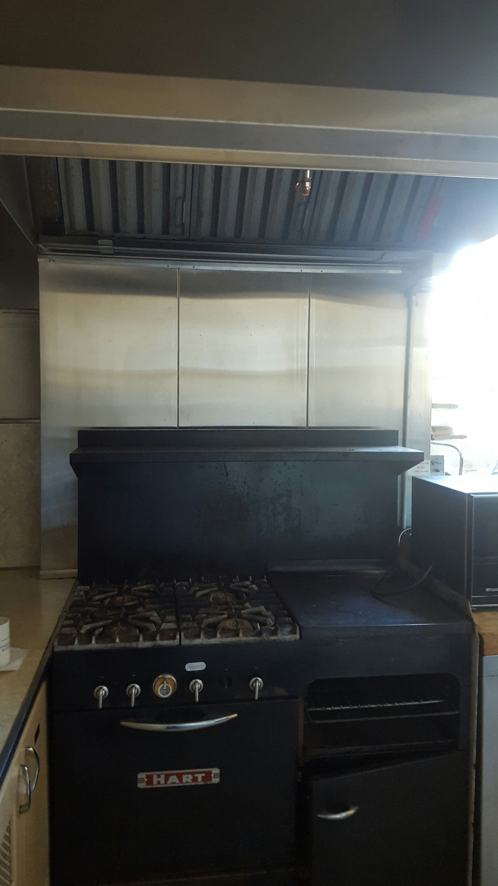
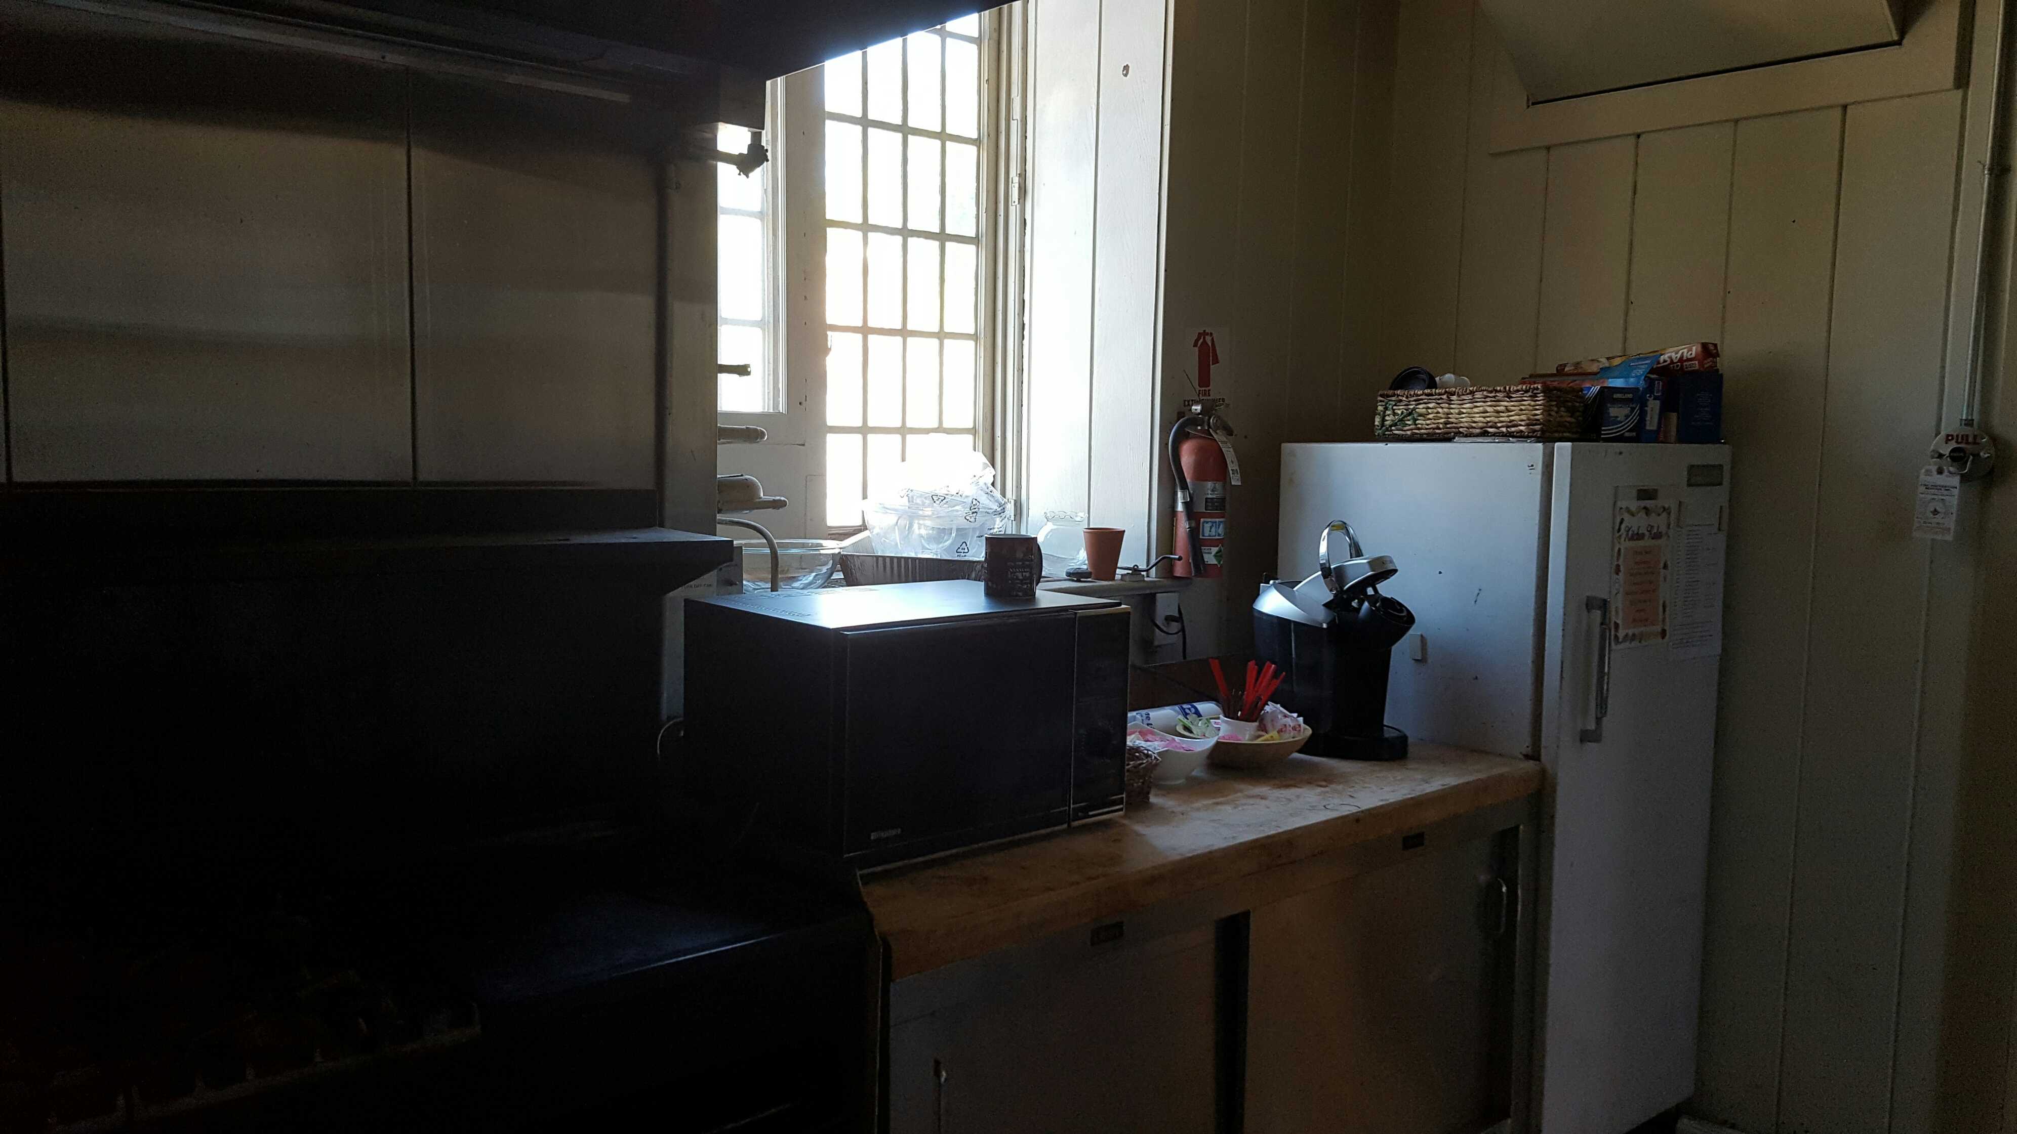
Main Floor – Kitchen and Natural Light

Slide 10
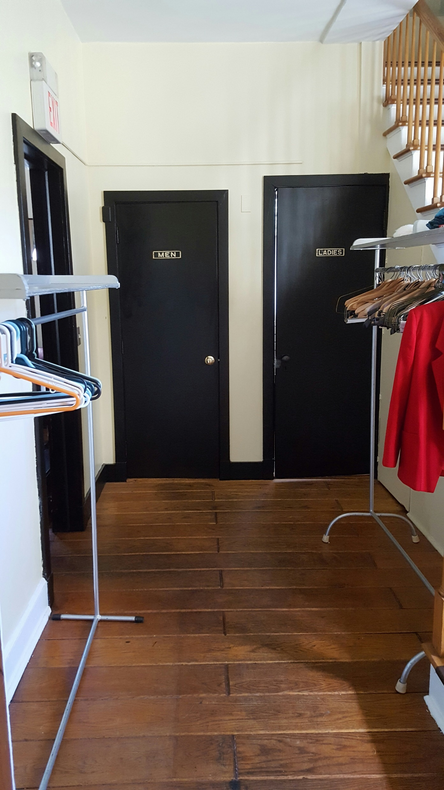
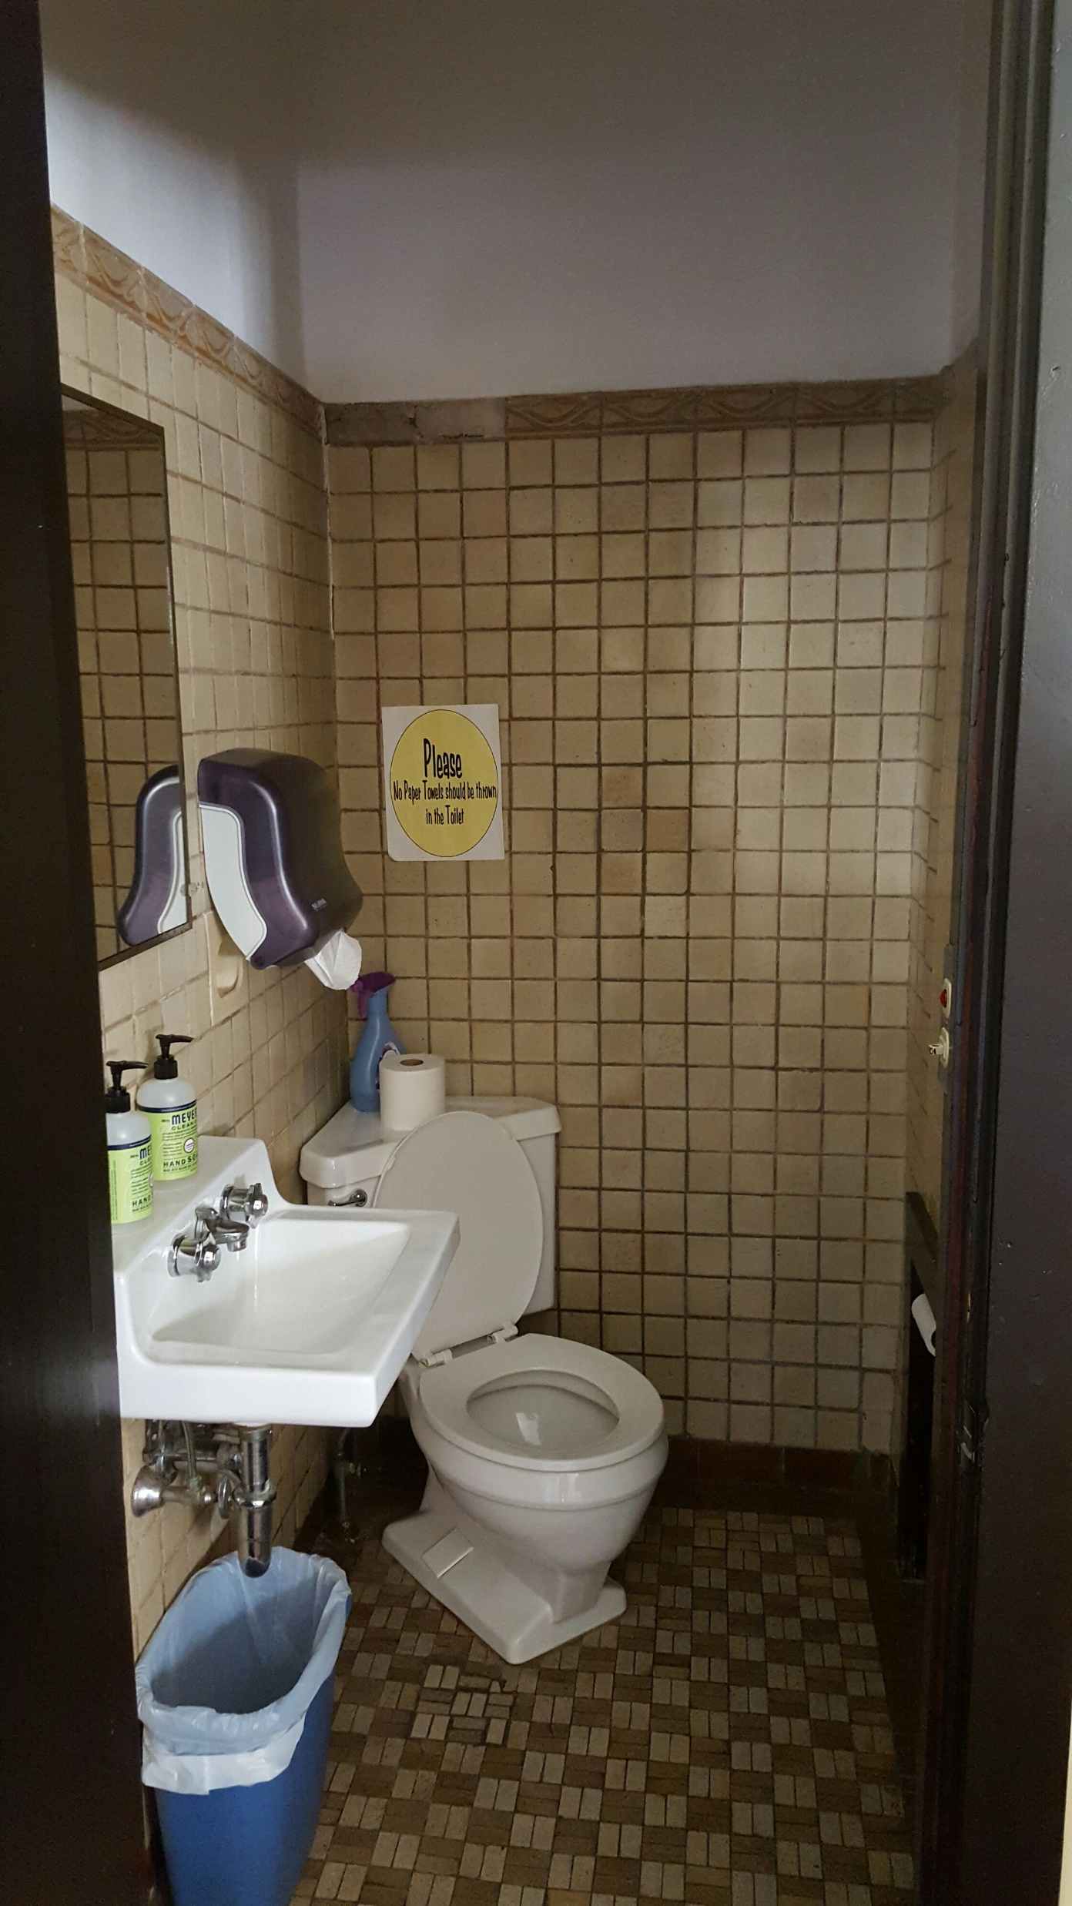
Main Floor – Bathroom/ Accessibility

Slide 11
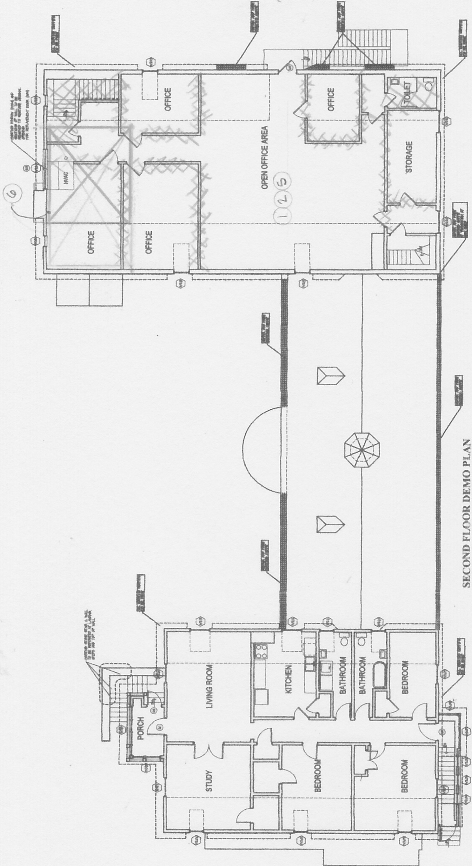
Existing Plans: major work areas - 2nd Floor

Slide 12
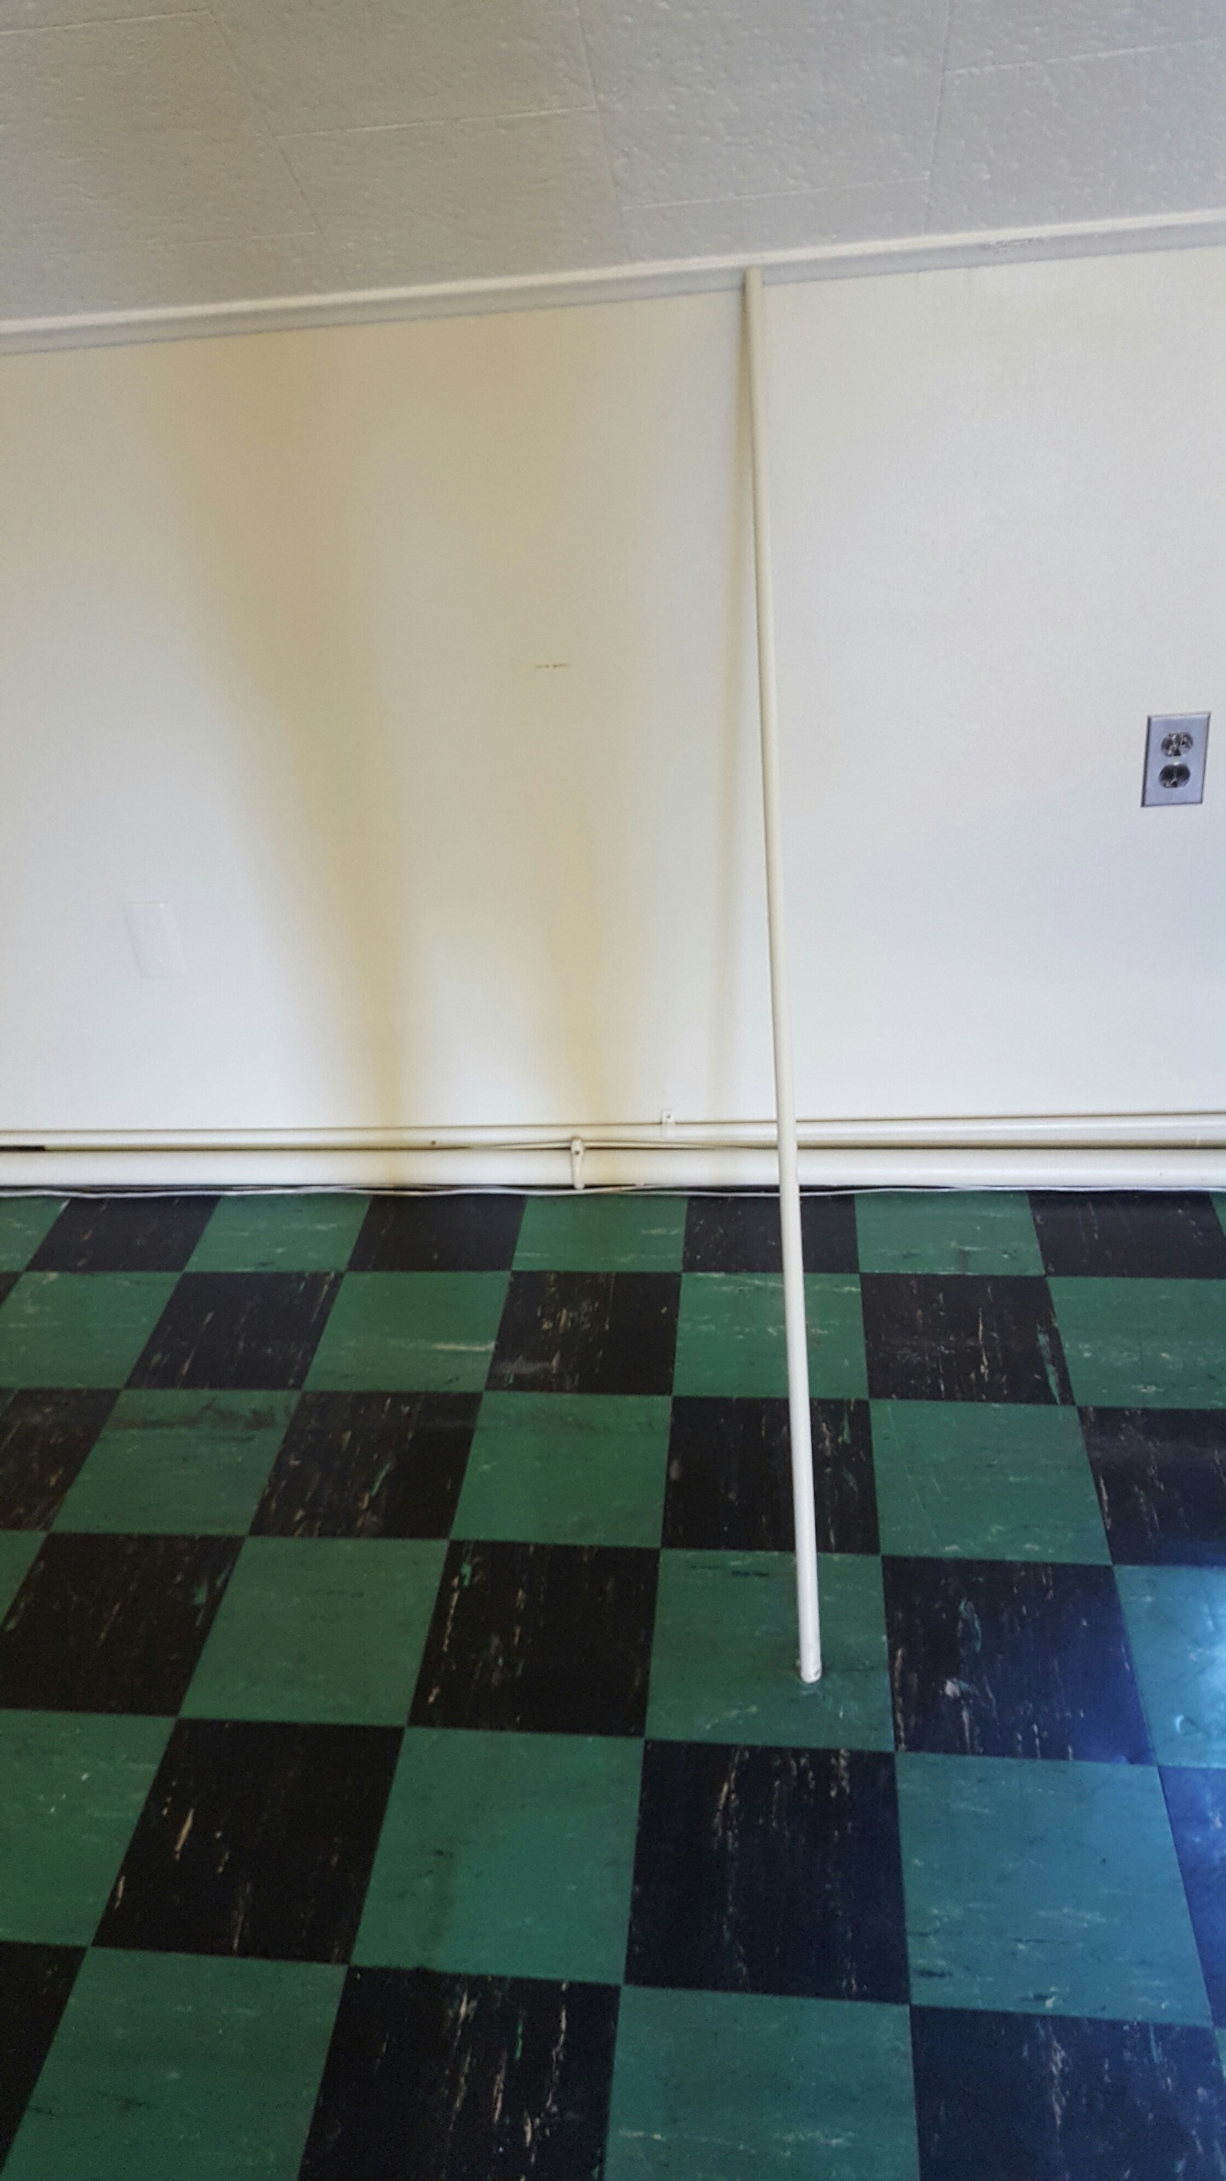
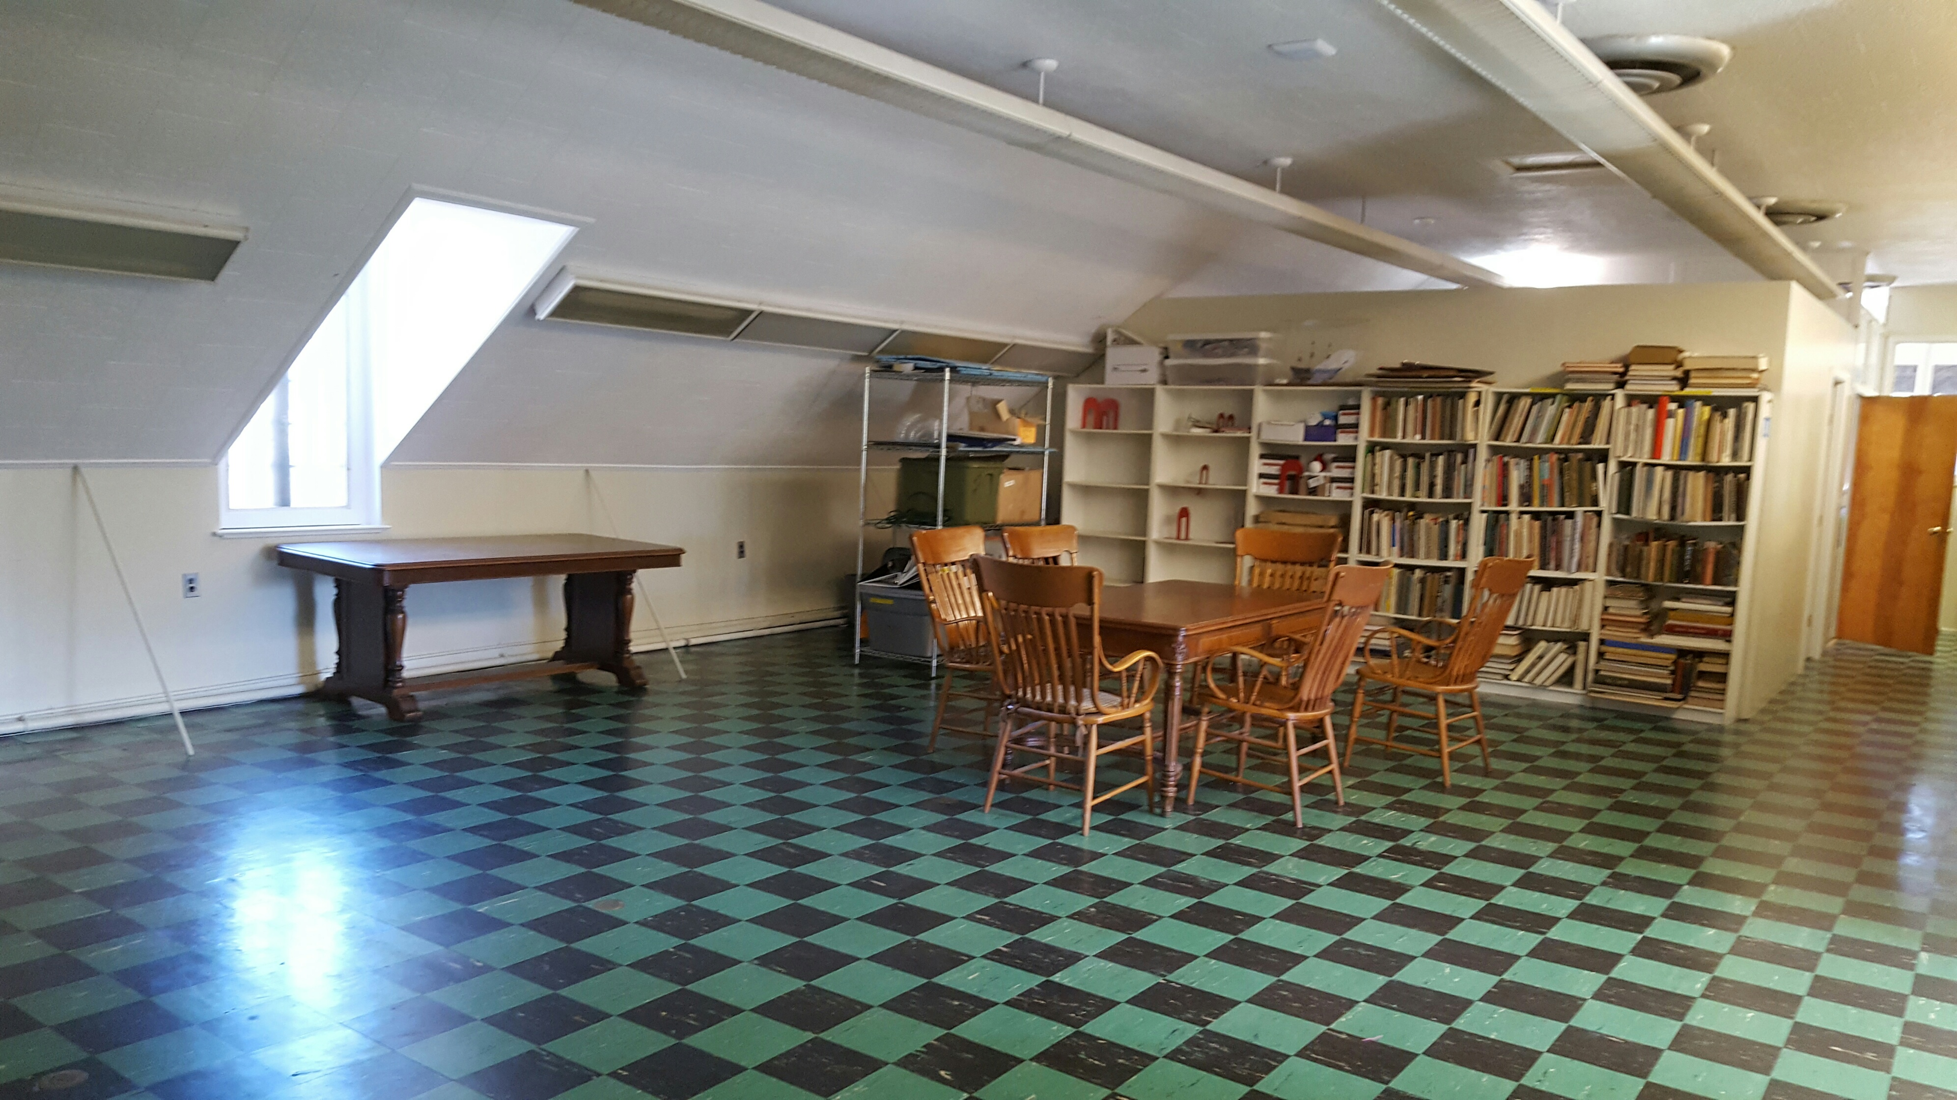
Second Floor – Asbestos/Structure/Capacity

Slide 13
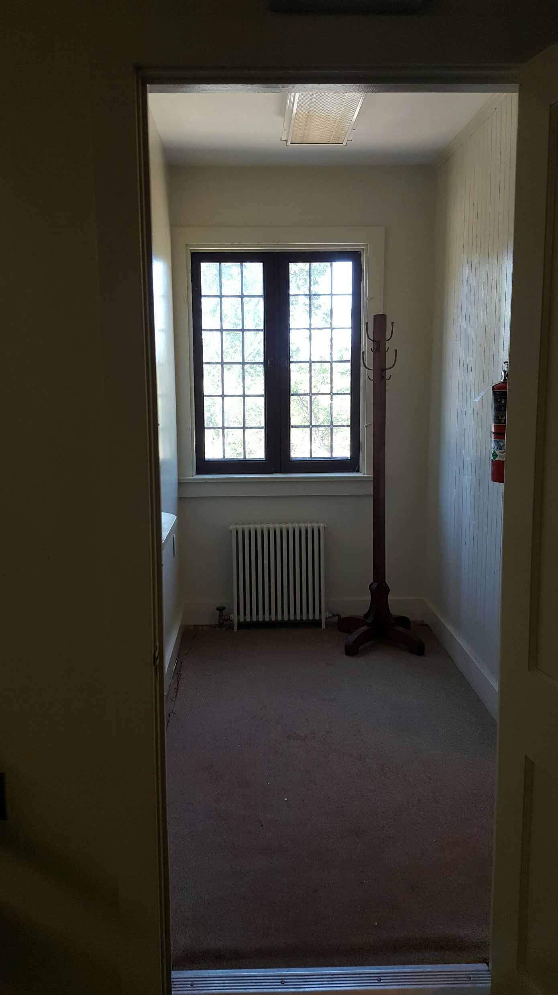
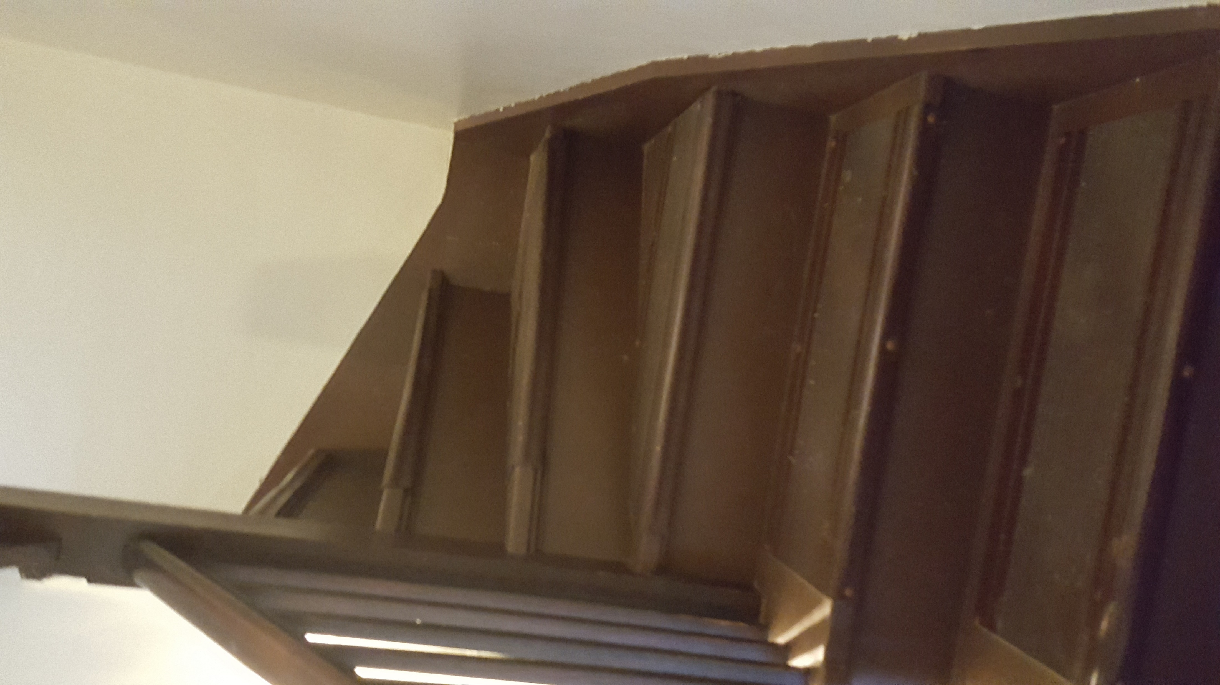
Second Floor – Natural Light and Access

Slide 14
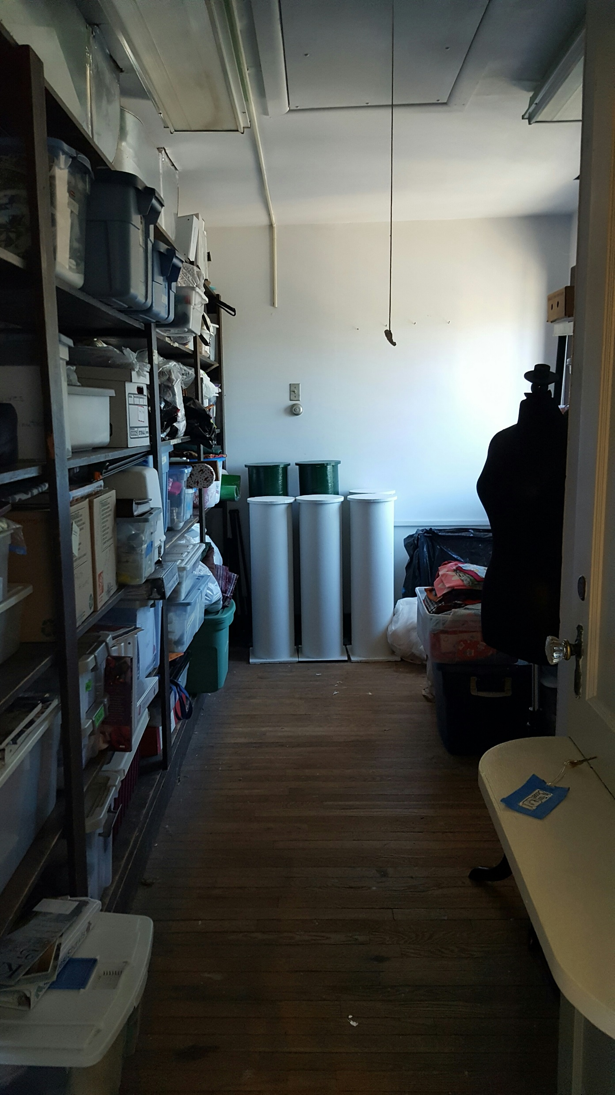
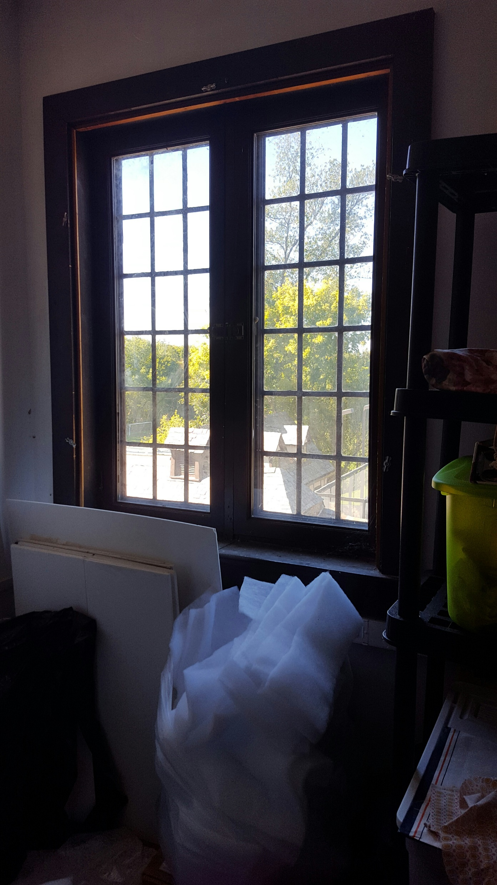
Second – Natural Light and Multiple Uses

Slide 15
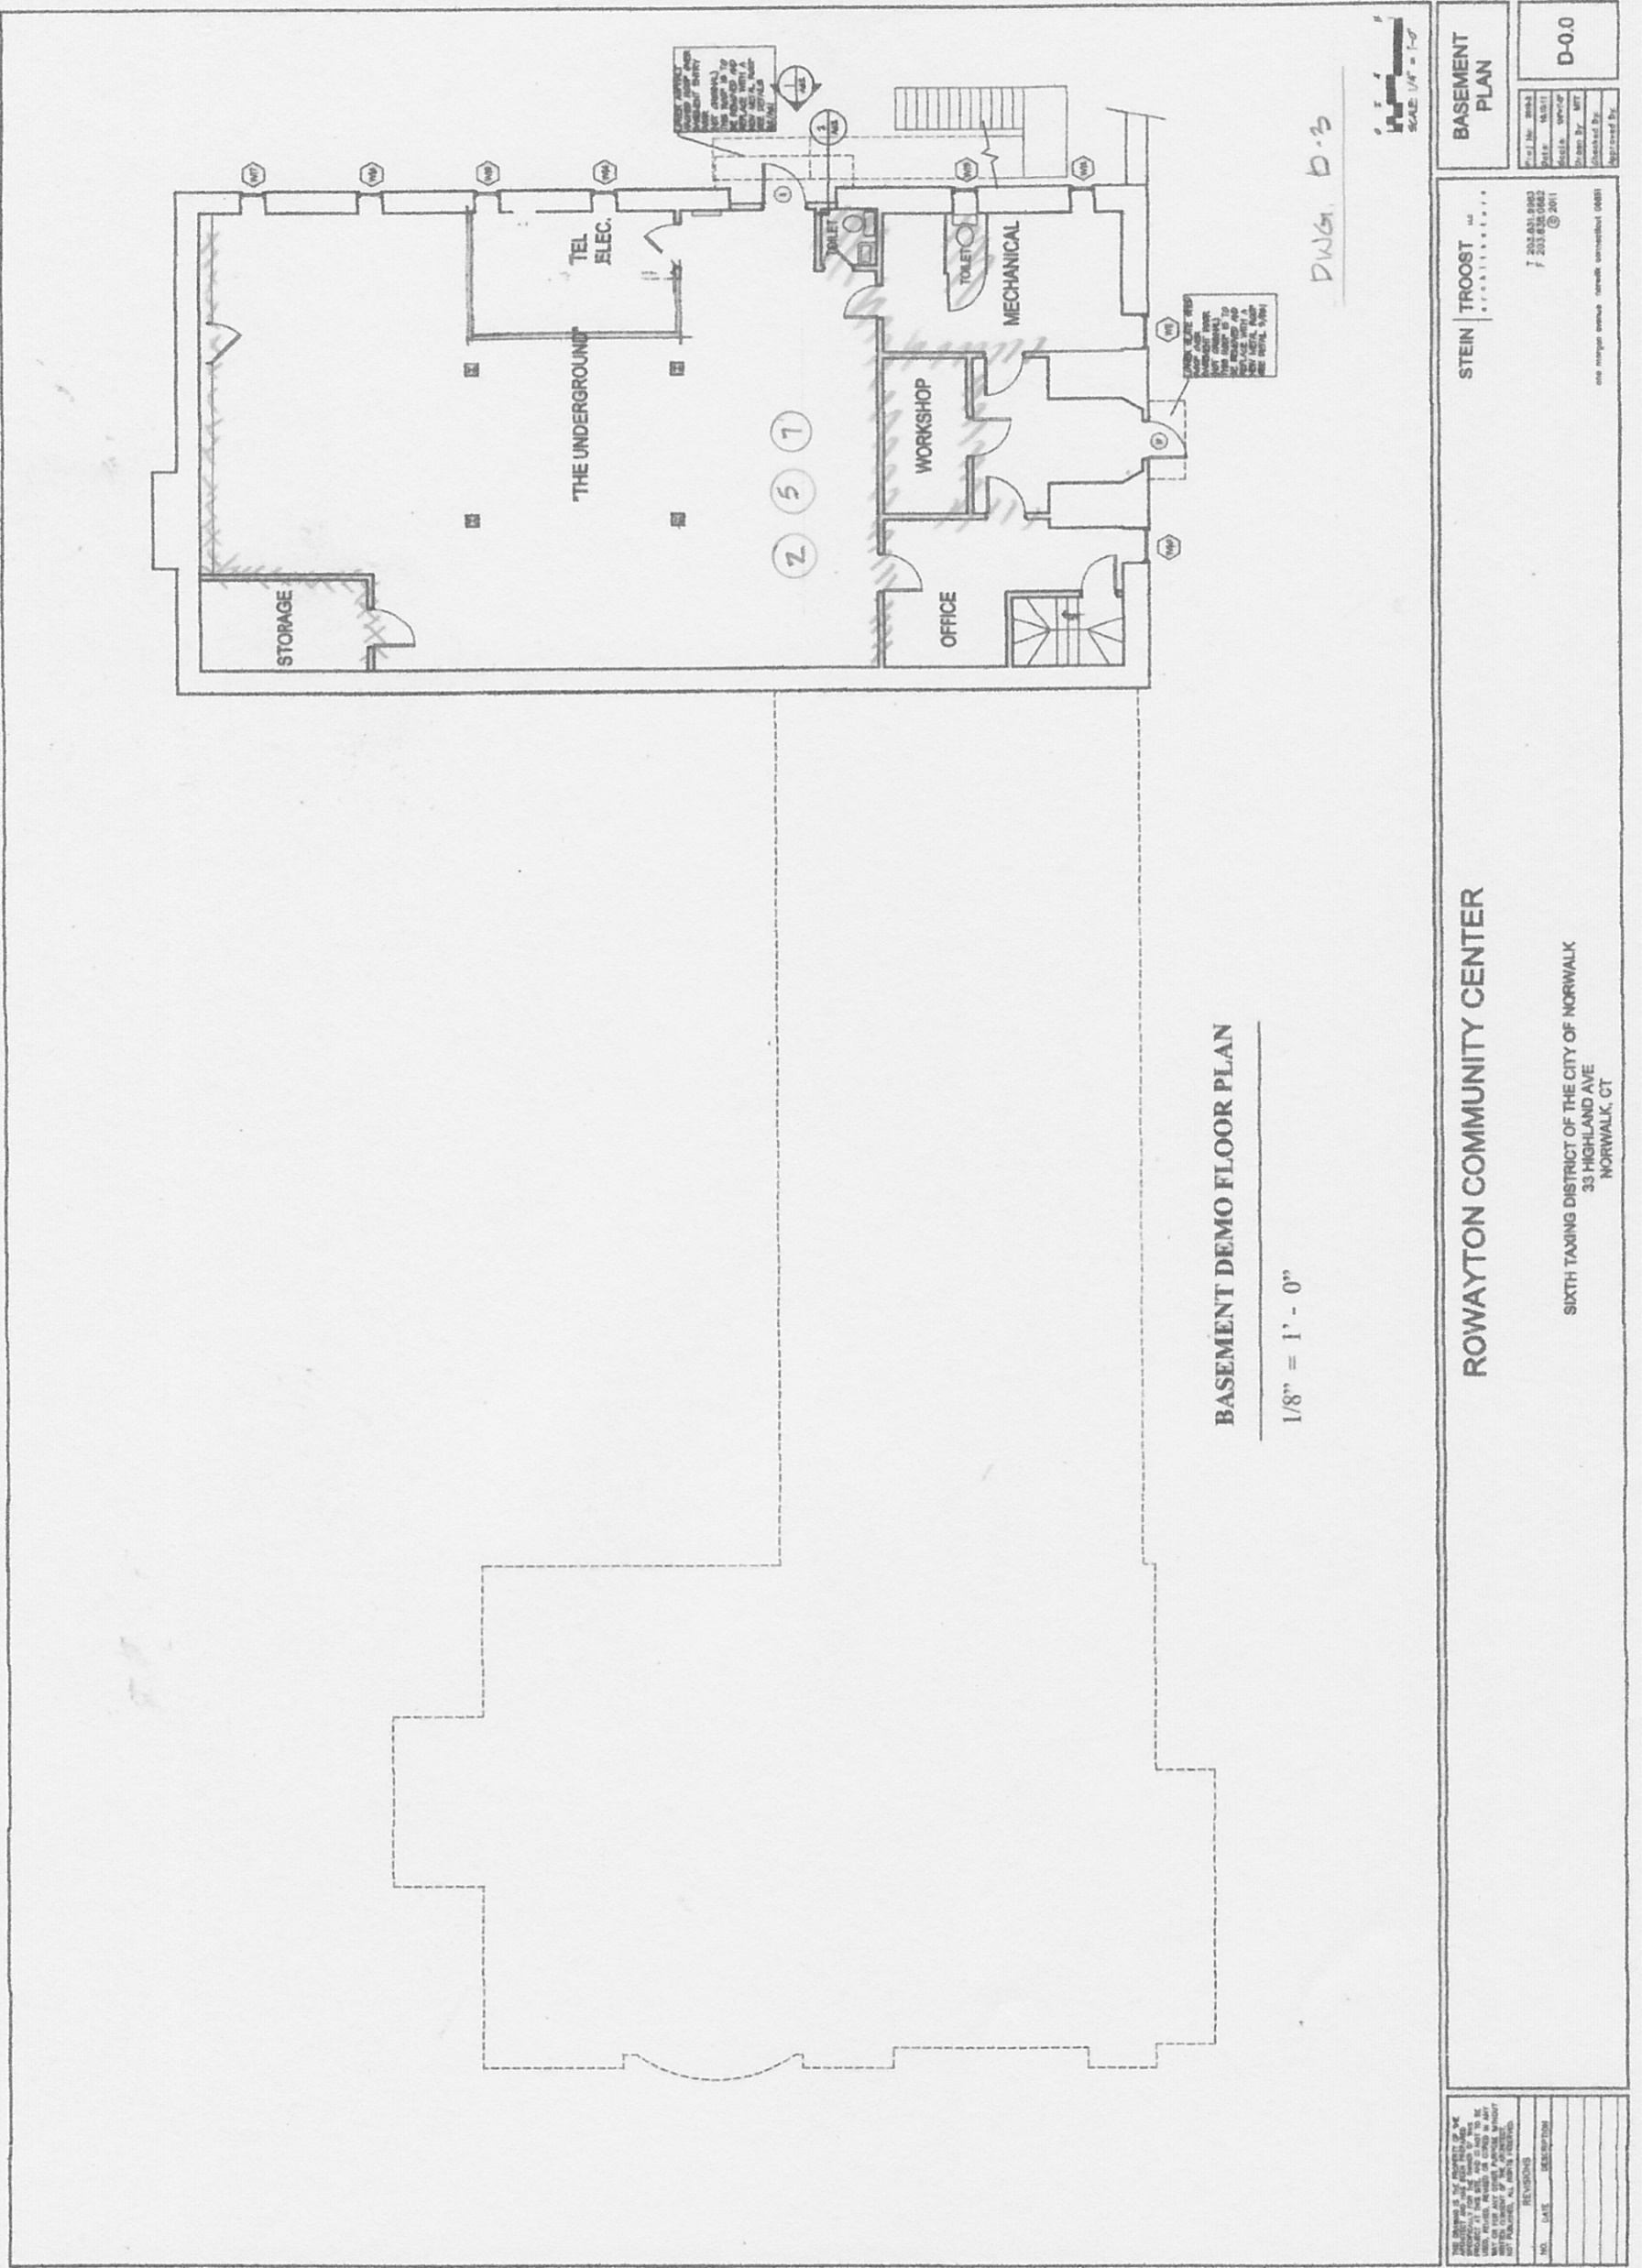
Existing Plans: major work areas - Basement

Slide 16
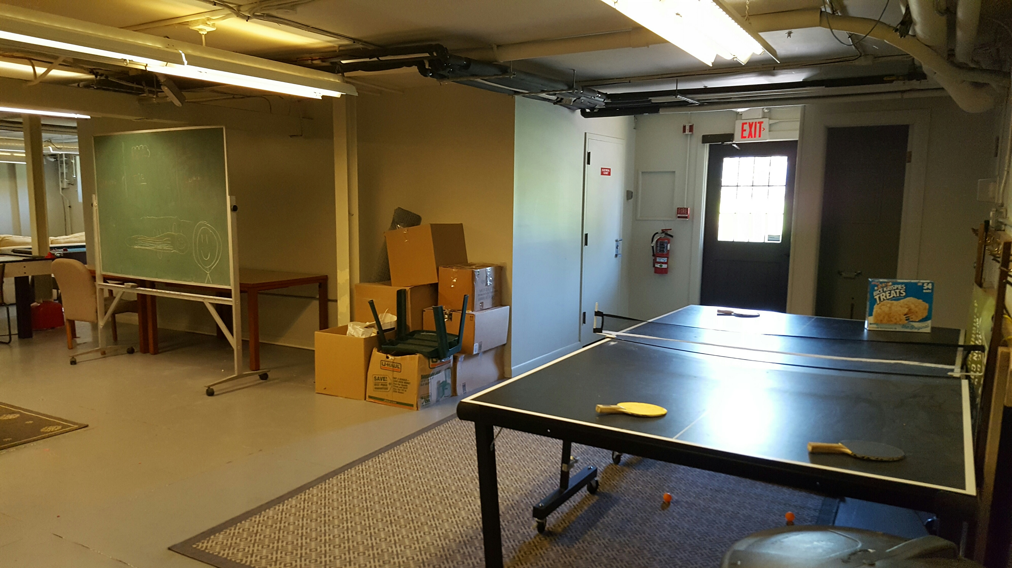
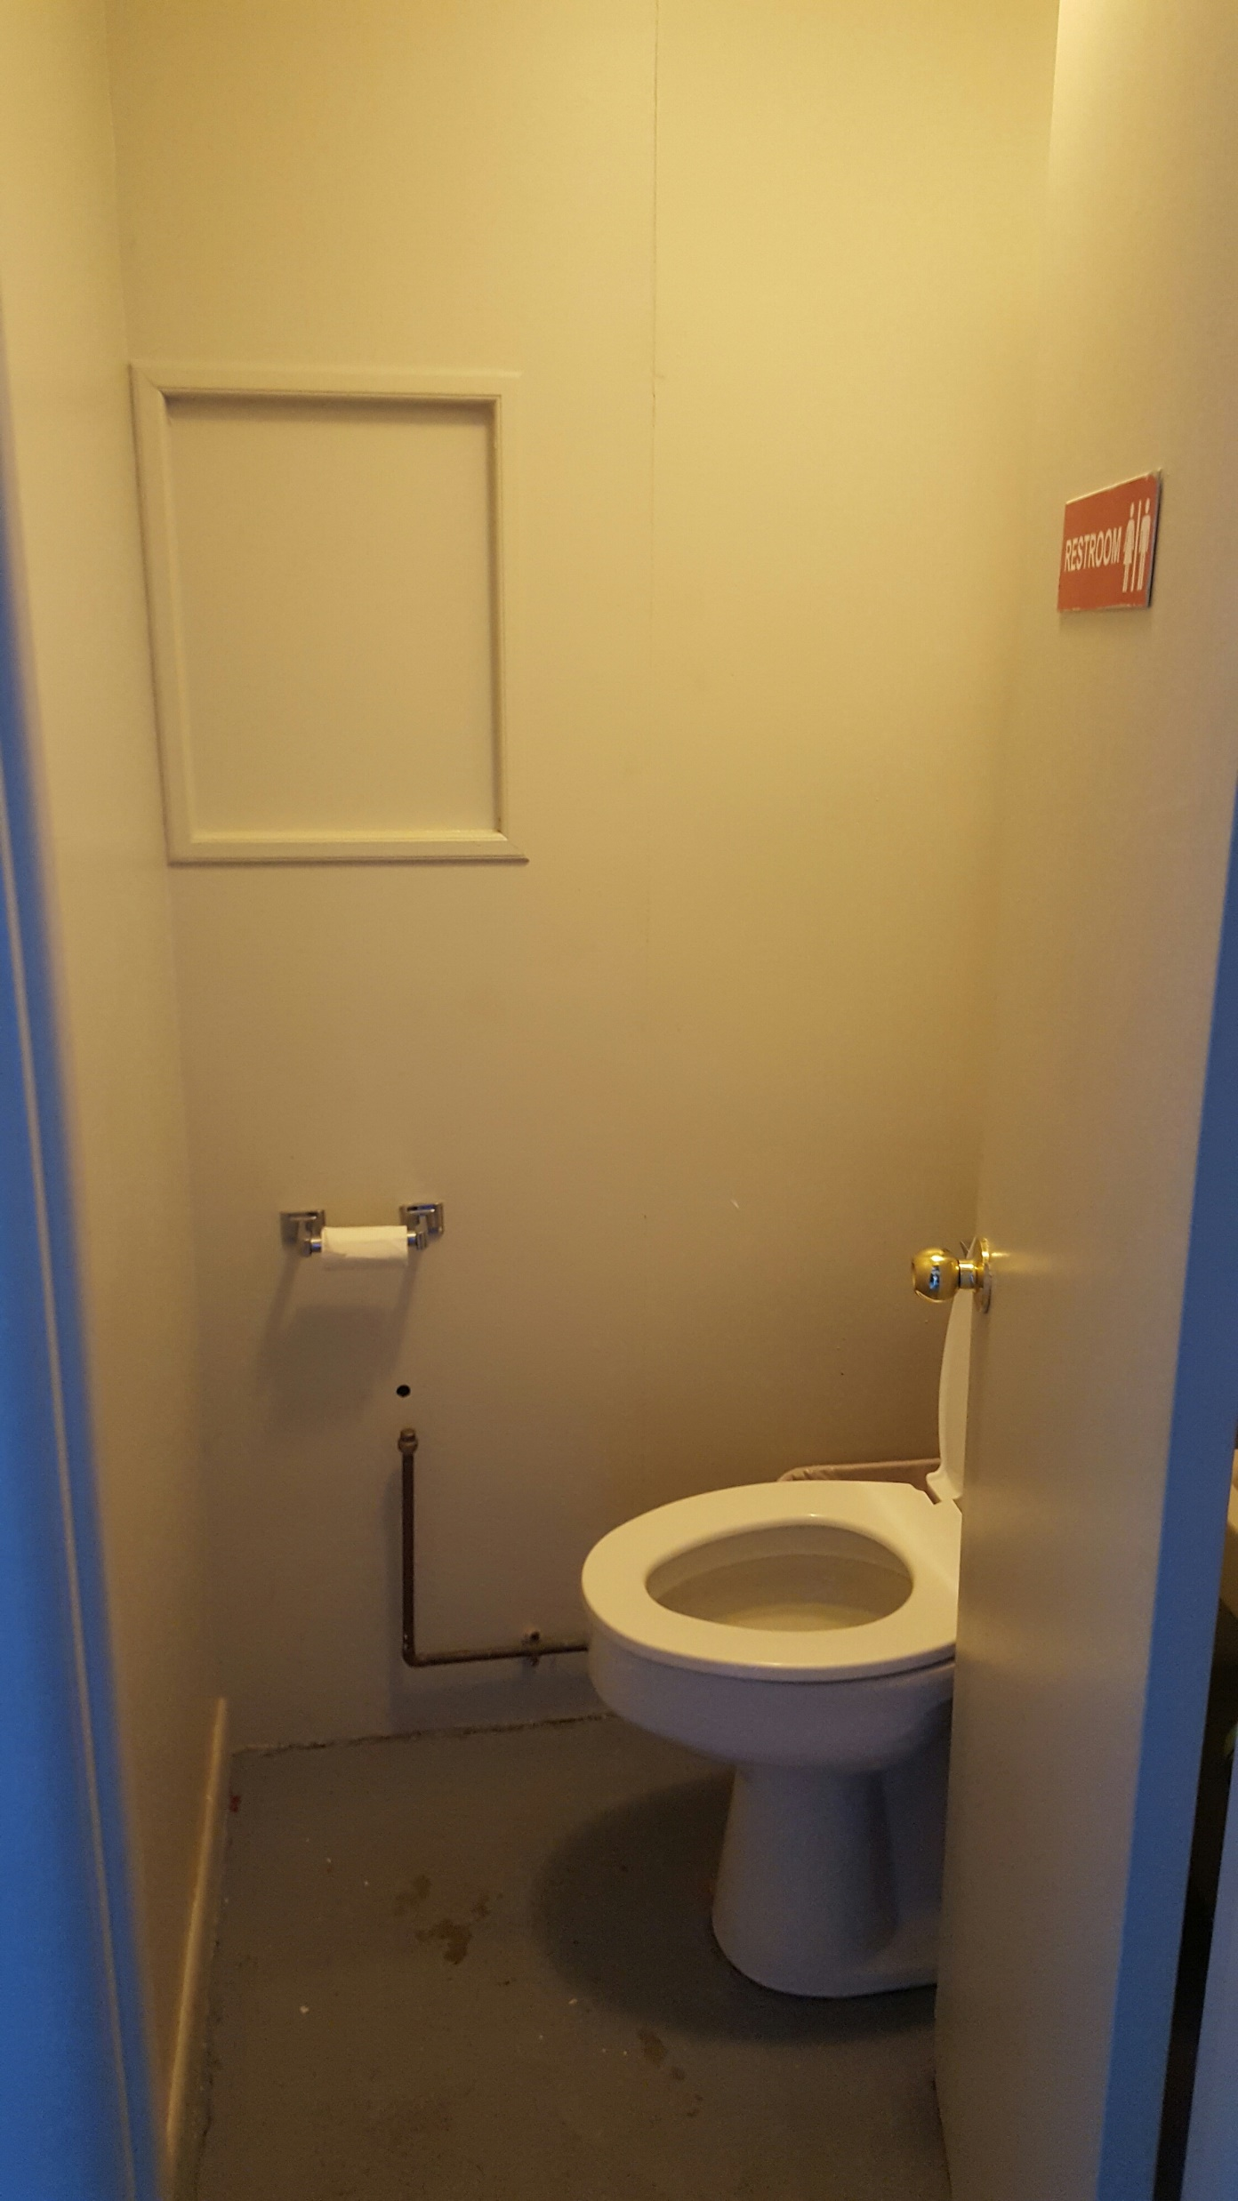
Basement – Bathroom and Outside Access

Slide 17
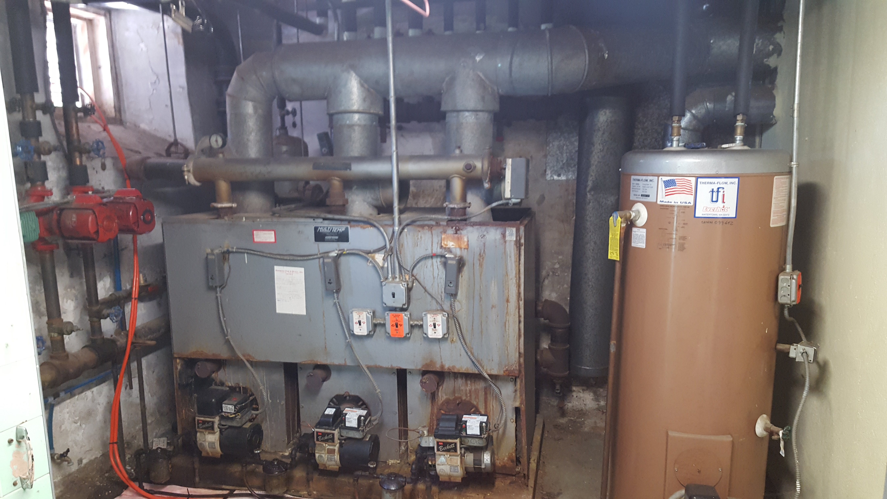
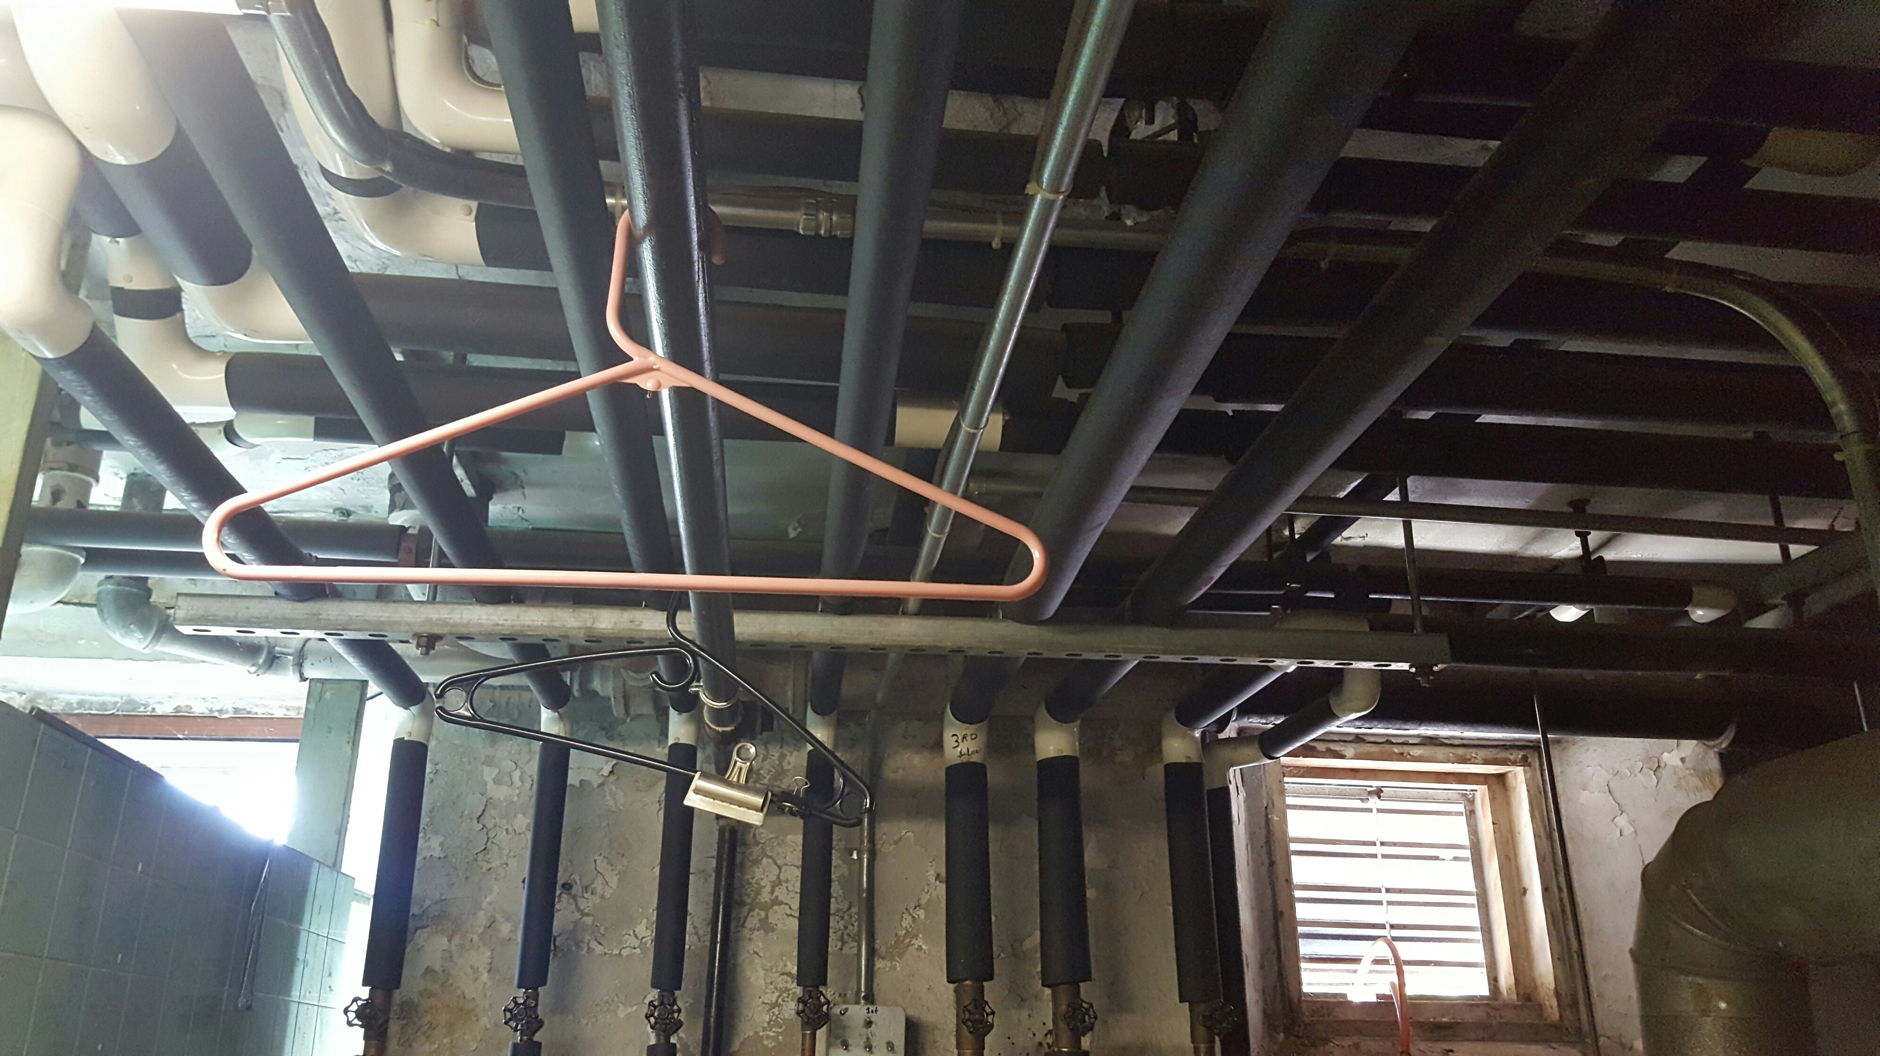
Basement – Boiler/ HVAC/Pipes
a

Slide 18
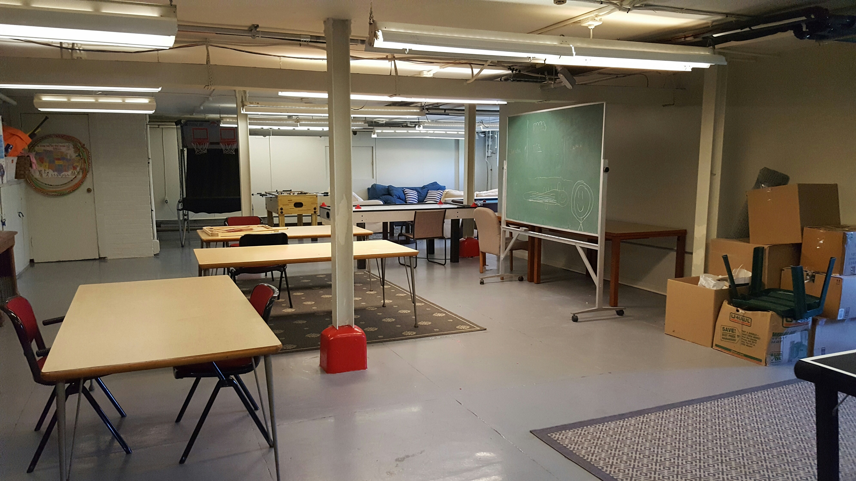
Basement – Usability and Storage

Slide 19
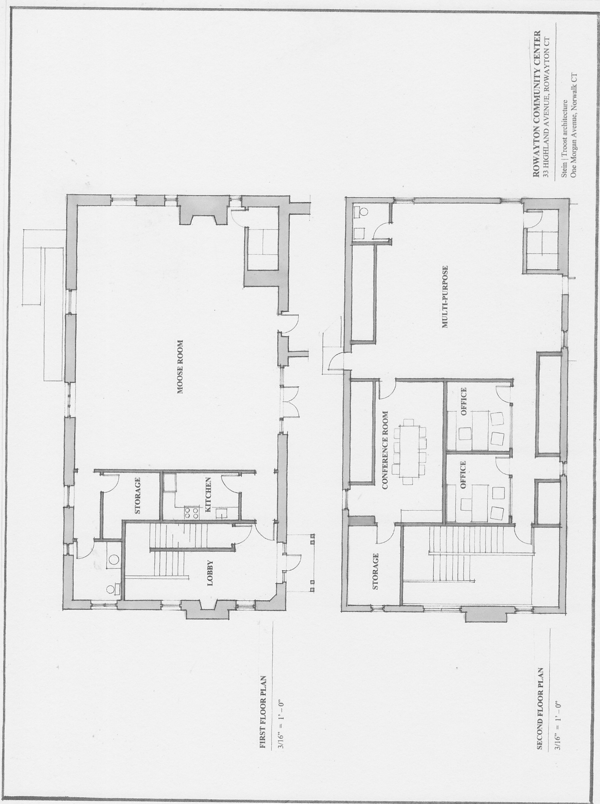
Proposed Plans – Main Floor & Second Floor

Slide 20
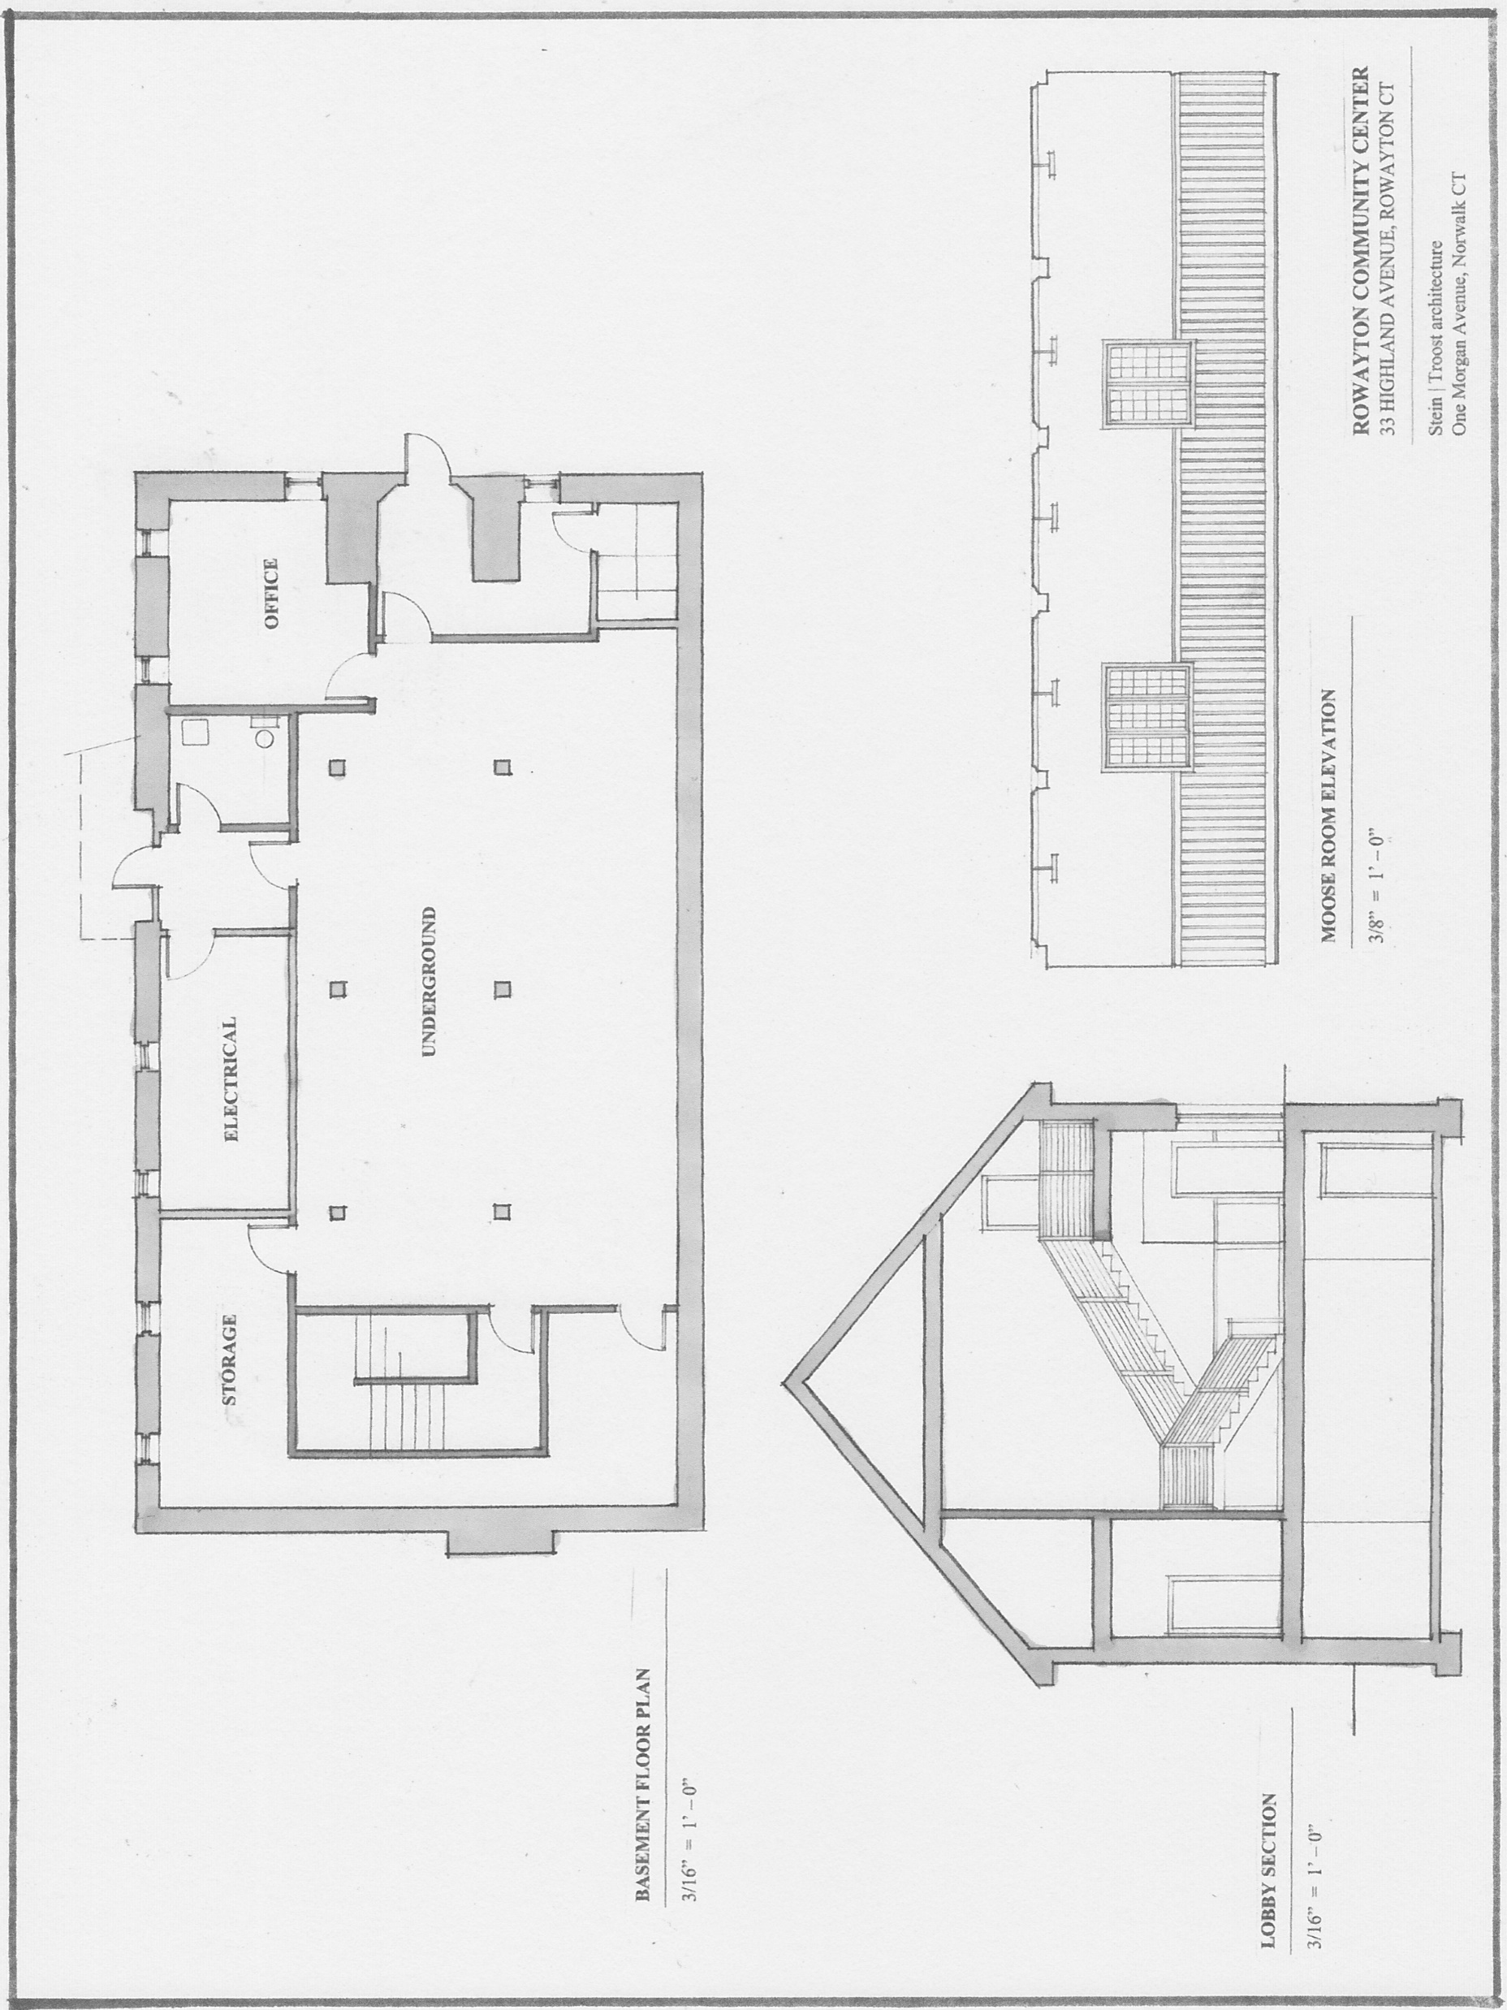
Proposed Plan – Basement & Building Section

Slide 21
Infrastructure Benefits of Interior Project
Defined main entry to RCC
Building wide environmental remediation (asbestos removal)
Complete building-wide HVAC System upgrade
Complete conversion from oil to gas (cleaner, cheaper)
New kitchen
Handicap accessible bathrooms
New fire rated staircases
Renovate Moose Room – ceiling lighting/wiring/flooring
Upgrade fire alarm and building safety
Maximize natural light

Slide 22
Programming Benefits of Interior Project
Enlarge capacity of Moose Room/more functional meeting rooms
New catering kitchen allowing for improved access
Use of Moose Room and kitchen without conflict or interruption
Maximize natural light
Develop programing space on Second Floor and Basement/Underground that is not currently suitable for use (e.g., meetings, tutoring, classes, community-based activities)
Improved storage for community groups including Rowayton Gardeners, Quilters, RCA, Knitters, Boy Scouts, Library
Exterior bathroom access (Paddle/Soccer/Gardeners)
Maintain historic integrity of building

Slide 23
Options
Full Project completed in 6-8 months
Full Project completed in 3 phases (time determined by funding)
Limited Project(s)–To be defined
    Moose Room
    Kitchen
    Bathroom – Exterior access
    HVAC
    Asbestos Removal
    Etc.

Slide 24
ROWAYTON COMMUNITY CENTER
POTENTIAL PHASING PLAN
8.13.16
Phase I
Move 2nd Floor Offices to Basement
Hazardous material abatement and 2nd floor demolition
Install new HVAC system for 1st Floor
Restore Moose Room (demo kitchen, new lighting, AV, flooring and ceiling)
AP Construction estimate - $239,600
Phase II
Renovate Underground (remove boiler, new bathroom, new lighting, new HVAC)
AP Construction est. - $207,400 (includes inflation and remobilization up-charge)
Phase III
Renovations to 3rd floor, new stair and lobby, bathrooms and 1st floor kitchen
AP Construction est. - $337,700 (includes inflation and remobilization up-charge)
Total Phase costs = $784,700
AP Construction Cost in single phase = $713,700

Slide 25
LTPCC Recommendations
Implement full plan in single phase as described
Limited inconvenience to users of RCC
Most cost effective approach
Most efficient management oversight
Eliminates financing uncertainty
Locks in current low cost of capital

Slide 26
Next steps
Refine cost estimate
District vote on November 16, 2016
Review final kitchen plans with potential users
Review final technology plans with potential users
Develop final plans and specs for bid package

